Slide 1

Kotlin 101 Basic Concepts

Slide 2

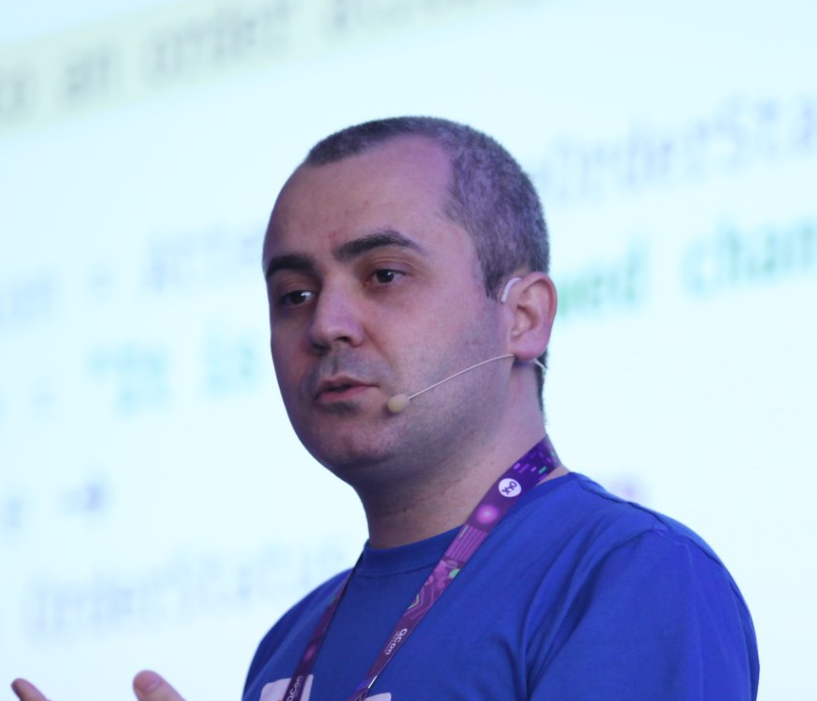
Augusto Branquinho
Github: bbranquinho
Email: augustobranquinho@gmail.com

Slide 3
1. Background

Slide 4

1. Background
Kotlin
Designed by
Java, Android, and Javascript
Native
Modern
Reduce the boilerplate
Kotlin in production: Google, N26, Pivotal, Uber, ...

Slide 5
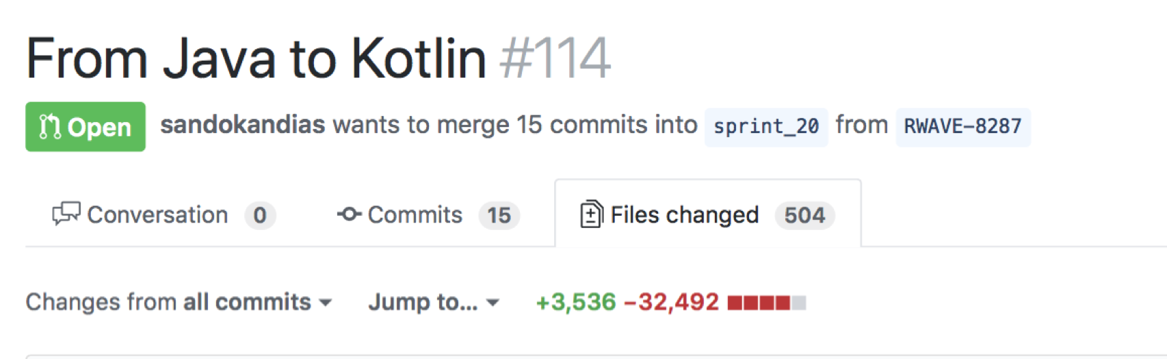

1. Background
Professional experience with Kotlin
2 years
Back-end projects
Microservices, Event Sourcing, CQRS, DDD, ...

Slide 6
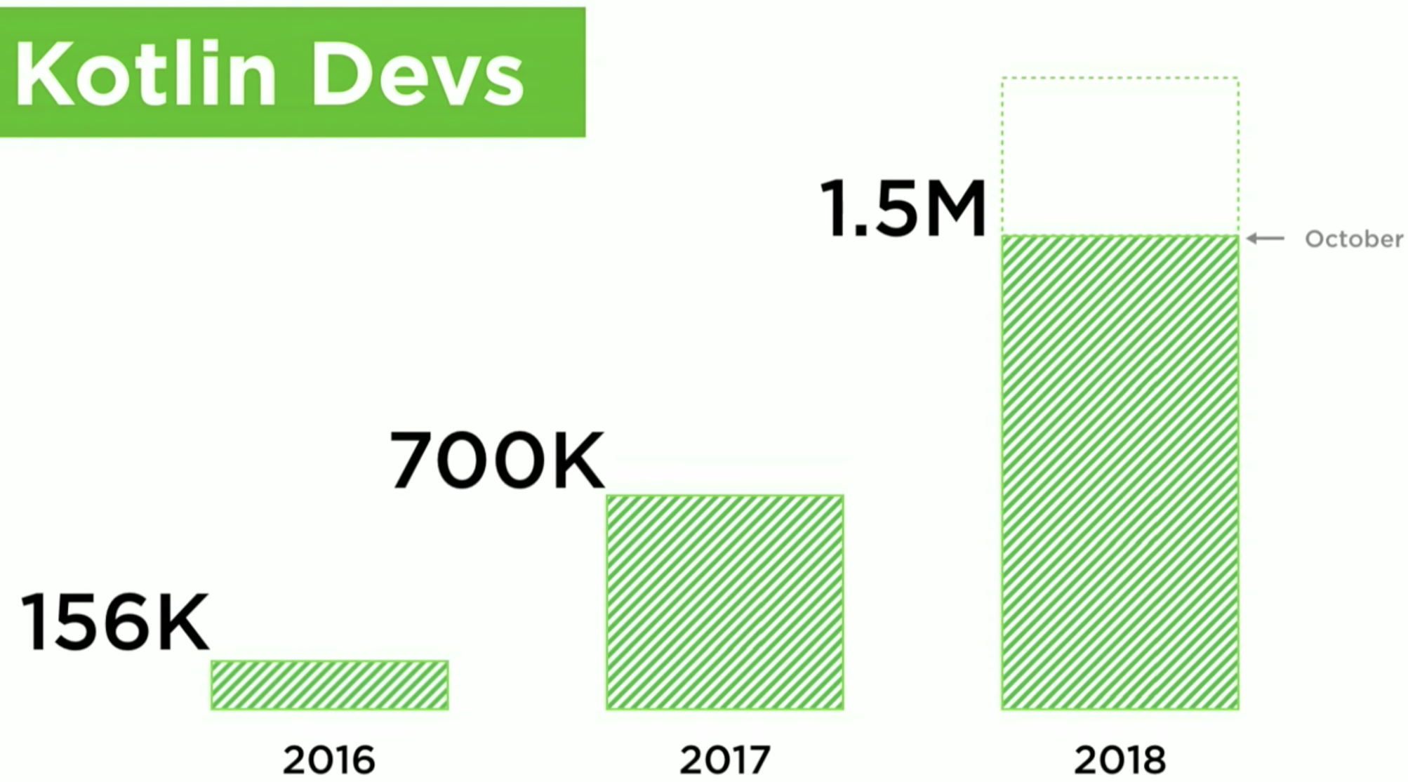
1. Background
Kotlin Conf 2018 by Andrey Breslav - https://www.youtube.com/watch?v=PsaFVLr8t4E

Slide 7
2. Benefits
“Readability, reuse, interoperability, safety, tooling.” Andrey Breslav – Kotlin Conf 2018

Slide 8
2. Benefits
Easy to learn
Fun to code
Used in production by many companies
Java Interoperability
Libraries: Spark Java, Spring, ...
Modern and clean
How Java can be improved?
New features (other languages)
Constant evolution
Multi-plataform

Slide 9

NULLs Everywhere

Slide 10

Kotlin is much safer than Java!

Slide 11

3. Challenges

Slide 12
3. Challenges
Teams speaking only Java
Interoperability
Old libraries (Java)
Order of Compilation
Specific Kotlin modules
Convince your company to try Kotlin

Slide 13
4. Basic Concepts
“We’ve gone from about 0 to 80% of new code in Kotlin in 2018 alone.”
Adam Conrad - Why Airbnb is Moving Off Of React Native

Slide 14
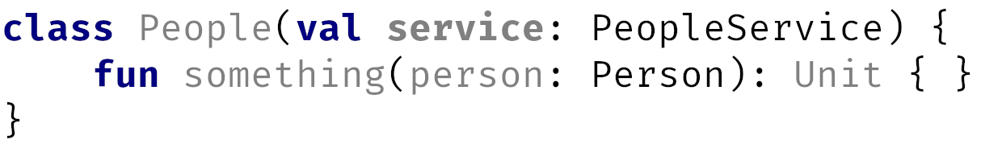
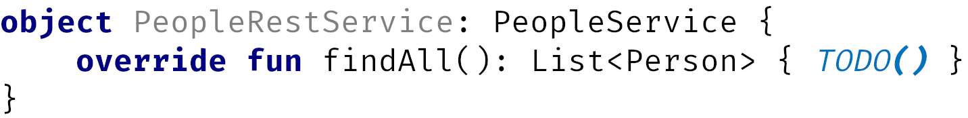
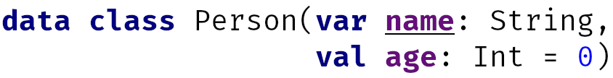
4. Basic Concepts
Class, Data class, Object

Slide 15
4. Basic Concepts
Data class
Equals
ToString
HashCode
Copy
“Builder”
Destructuring Declarations

Slide 16
4. Basic Concepts
Null safety
High order function
Extension methods
Inline
Reified
Lambda

Slide 17
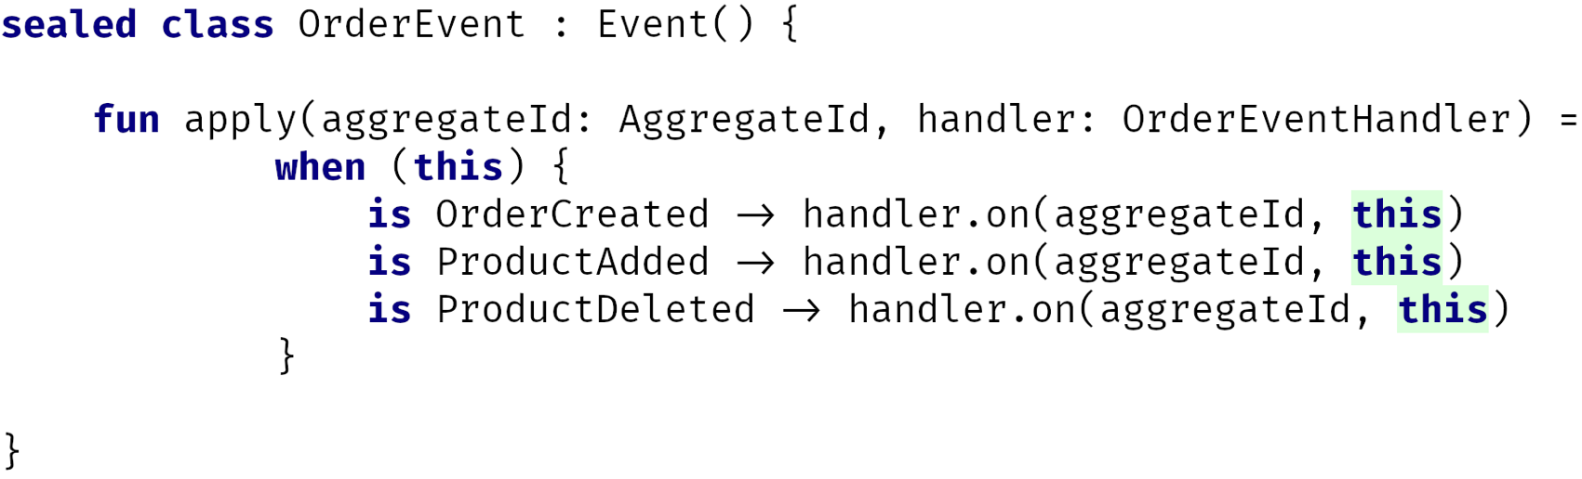
4. Basic Concepts
Sealed class

Slide 18
5. Conclusion
"Kotlin is beautiful!”

Slide 19

5. Conclusion
Try Kotlin: https://try.kotlinlang.org

Slide 20
5. Conclusion
Future
Coroutines
Functional programming
Tailrec
Live coding
Ktor
Spring + Kotlin
Kotlin Native
Kotlin JS
...

Slide 21
THANKS!
Any questions?
Github: bbranquinho
augustobranquinho@gmail.com

Slide 22
References
Kotlin Conf 2018- Keynote: https://www.youtube.com/watch?v=PsaFVLr8t4E
Foundation: http://kotl.in/foundation
Coroutines: http://kotl.in/coroutines
Kotlin Native: http://kotl.in/native
Multiplataform: http://kotl.in/multiplatform
Learn: http://kotl.in/learn
Airbnb: https://softwareengineeringdaily.com/2018/09/24/show-summary-react-native-at-airbnb/

Slide 23
Credits
Special thanks to all the people who made and released these awesome resources for free:
Presentation template by SlidesCarnival
Photographs by Unsplash

